Slide 1
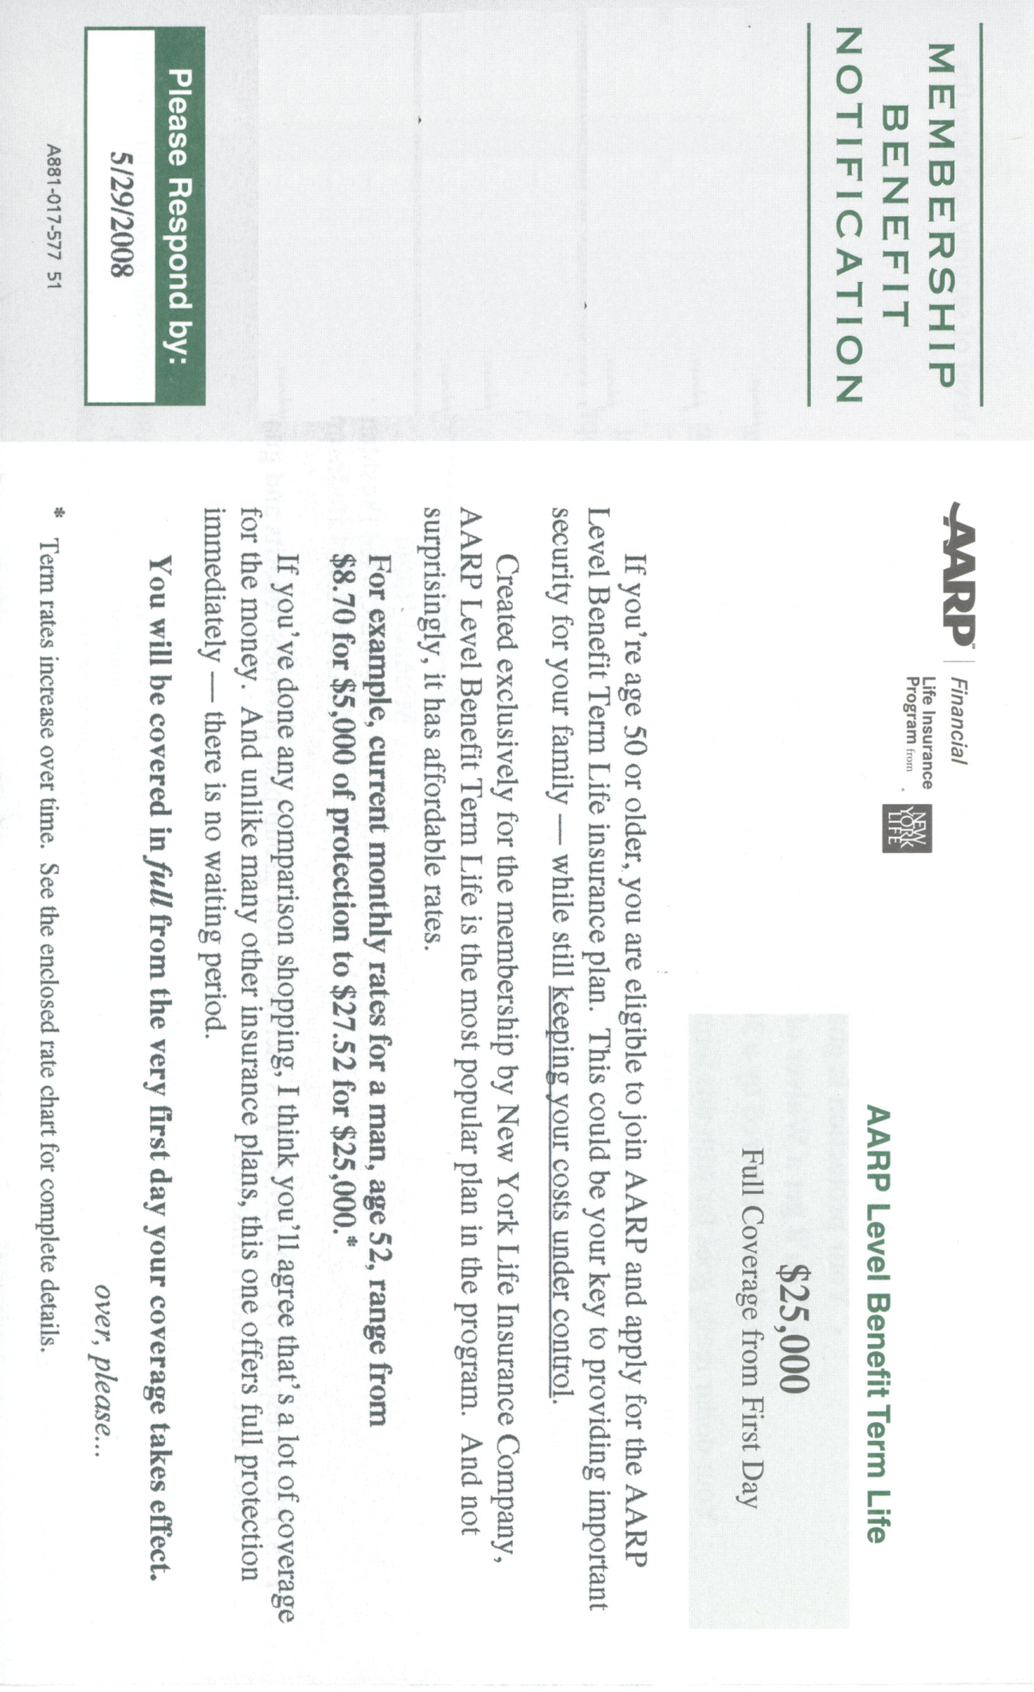
Ms. Templin:
In an effort to make life insurance more affordable even for the uninsurable, we’re offering this plan to our over 70 members only. No medical poking and prodding is required. You can apply from the comfort of your own home in your jammies.
If you’re not an AARP member, it’s hard to join. Just go back to work, and you won’t have to worry about a thing. If you insist on retiring, use the enclosed form to join today.
5/29/2009
Dear Ms. Templin:
Since you’ll be age 55 or older, you are eligible to join AARP and apply for the AARP Sliding Benefit Term Life Insurance Plan. This could be key in providing security for plants and animals in the event of your untimely demise ---- while still keeping costs in our control.
Created exclusively for Northwest Insurance retirees by the New York Life Insurance Company, the AARP Sliding Benefit Term Life Insurance Plan is the most popular plan in the program for handicapped and legally blind people over the age of 54. And not surprisingly, it’s CHEAP!
  For example, current monthly rates for a woman, age 55, legally blind and deaf in one ear range from $2.35 for $2,000 of protection to $89.73 for $3,000*.
If you done any comparison shopping, you already know that no one else would cover you, even for a million dollars. An unlike other plans, this one has no requirements, and there is no waiting period ---- you need to be protected RIGHT AWAY!

Slide 2
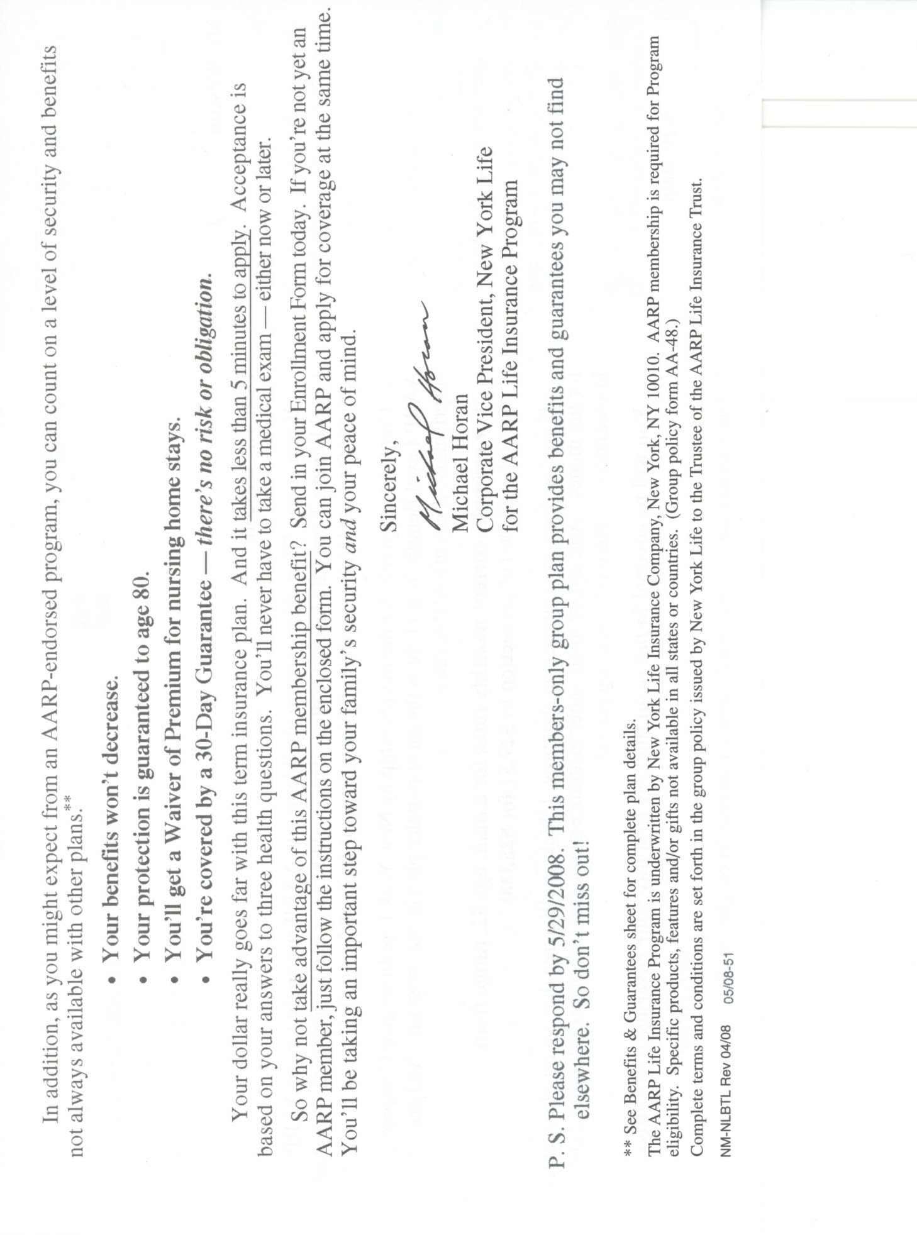
AARP Handicapped and Destitute Money Laundering Program
In addition, you can count on a sliding scale of security and benefits just when you need it most; the more you need it, the less there’ll be
  Your benefits will decrease,
  Your protection isn’t guaranteed to age 80,
  You’ll get a premium increase for nursing home stays,
  You’re covered by a 2-Day Guarantee, ---- no money back!
Your money really goes far with this program, leaving more for your own enjoyment. For about the cost of a salad bar at Pizza Hut, you and your plants and animals can rest easy. And remember, there’s no medical exam; we already know your problems and that you’ll be rated as high as possible.
5/29/2009.

